Slide 1
TNCompass
TNCompass

Slide 2
TNCompass

Slide 4
Professional Development Renewal Guidelines
All educators must earn professional development points to advance or renew a teacher license, including teacher licenses, occupational licenses, and professional school services personnel licenses. If an educator chooses to advance from the practitioner to the professional license using PDPs, the educator must accrue 30 PDPs. To renew the professional license, an educator must accrue 60 PDPs.
Activities cannot be part of the state funded in-service days and cannot be conducted during days and/or hours for which educators are already being paid by local education agencies. Activities cannot be completed during school hours.
Activities must be completed within the validity period of the license being advanced or renewed.
Activities must be related to the development of content knowledge, pedagogical knowledge or pedagogical content knowledge; activities designed to enhance educator effectiveness (e.g., world language courses for educators who work with students for whom English is a second language, coursework designed to support educator’s understanding and use of student data) or other activities designed to improve instructional practice qualify for PDPs. Activities that are not related to the development of educator effectiveness do not qualify for PDPs. Examples of activities not accepted include: athletic coaching or clinics, bus drive competitions, club sponsors, choral/band presentations, camp director or Christian education.
College/University coursework must be completed at regionally accredited institutions.
At the time of advancement or renewal, if the educator is employed in a Tennessee public school, the local education agency must retain documentation for each completed activity for which the educator is awarded PDPs. The local education agency will be required to verify that educators accrued sufficient PDPs to qualify for advancement or renewal.
At the time of advancement or renewal, if the educator is NOT employed in Tennessee public school, the educator must submit documentation of all activities for which the educator requests PDPs. Each activity must be listed on the appropriate form and include appropriate documentation. The form must be signed by the person responsible for conducting the local evaluation.

Slide 5
Professional Development Points using Evaluations
TNCompass
Click on the Licensure Tab
Count your PDP’s under “Points Earned” if any. You will need a total of 60 renewal points. If you do not have 60 PDP’s using your evaluations, you can enter your PDP activities.

Slide 6
In this example, the educator has earned 55 PDP’s using their evaluation and needs 5 PDP’s using their activities in order to have a total of 60.
Professional Development Points 0 pending requests
Overall Evaluation Scores
 | Evaluation | Category | Description | Date Awarded | Points Earned
 | 2011-2012 / Knox County / Teacher | Overall Evaluation Score |  | 06/01/2012 | 10
 | 2012-2013 / Knox County / Teacher | Overall Evaluation Score |  | 06/01/2013 | 15
 | 2013-2014 / Knox County / Teacher | Overall Evaluation Score |  | 06/01/2014 | 0
 | 2014-2015 / Knox County / Teacher | Overall Evaluation Score |  | 06/01/2015 | 20
 | 2015-2016 / Knox County / Teacher | Overall Evaluation Score |  | 06/01/2016 | 10
Total: 55 PDP’s

Slide 7
Professional Development Points using Activities
TNCompass
Adding and Submitting PDPs for Approval
Click on My Educator Profile from the Home page.
When the Educator Profile page displays, click Licensure tab.

Slide 8
TNCompass
On the Licensure page, scroll to section for Professional Development Points (PDPs) and click the Add PDPs
button.
When the PDP Wizard displays, select the Type of Activity from the drop down list, such as Training, Coursework and/or National Board Certification for the PDP and include the Date Completed, Course Title/Seminar Name/Title, the number of Clock Hours, CEUs, Semester Hours, Points Accrued, etc. When all entries are completed, click the Add button.

Slide 9
TNCompass

Slide 10
TNCompass
More than one activity can be entered for the PDP request.

Slide 11
TNCompass
To remove an activity after it has been added, click on the trash can icon to delete the line item.
When the activity/activities appear in the list click the Continue button.

Slide 12
TNCompass
A summary of the new PDP activities displays.The Review and Submit step in the PDP Wizard tracks progress. Click the Submit button to send the PDP request to the principal or assistant principal for approval.
The Licensure tab now updates with the requested PDP activities including the Status of the request. The Status is of the PDP request is updated as the PDP request is processed.

Slide 13
How to Start a License Renewal Transaction
TNCompass
Under the Transaction tab click on “Start a new transaction”
Select the type of change you are requesting (renew license, name change, add degree, add endorsement etc.). The system will walk you through the steps to submit the request.

Slide 14
TNCompass

Slide 15
TNCompass
The next screen confirms the transaction being requested and provides helpful information regarding the transaction type
On the next screen, click on “Start Transaction” and the system will guide you to the end.

Slide 16
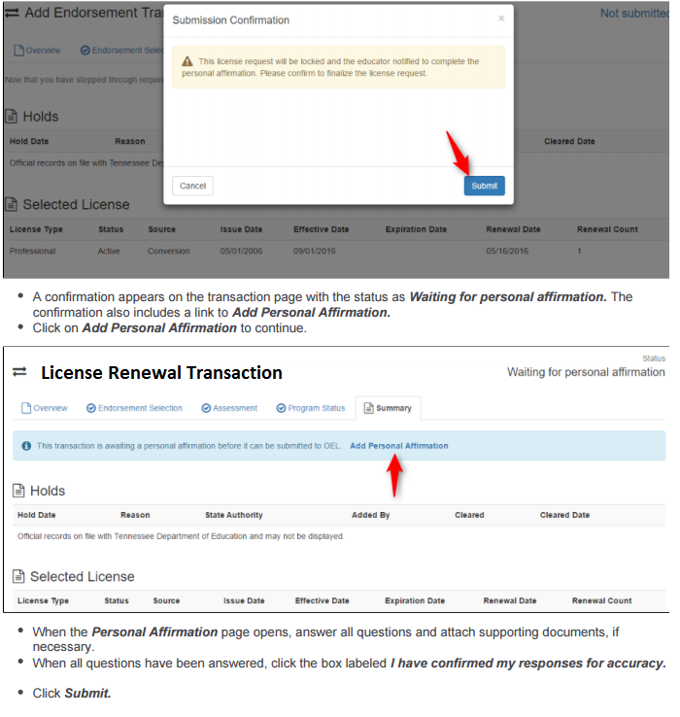
TNCompass

